Slide 1
Basic
Data
Structure

Slide 2
What is Data Type?
Data types encompasses a particular kind of data item, as defined by:
the values it can take
the operations that can be performed on it

Slide 3
Data types
Basic data types
Compound data types
Enumerated Type
boolean
Class
integer
float/double
Array
Pointer
character
Unions
Data structures
Stack
List
Table
Tree
Queue
File
Graph

Slide 4
Basic vs. Compound Data Types and Structures
Basic data types CANNOT be divided into simpler parts
Compound data structures are BUILT from data of basic types
Data structures are implemented based on Abstract Data Types (ADT)

Slide 5
Variations of Integer in C++
Type | Bit width | Range
int | 4 bytes | -2147483648 to 2147483647
unsigned int | 4 bytes | 0 to 4294967295
short int | 2 bytes | -32768 to 32767
unsigned short int | 2 bytes | 0 to 65,535
long int | 4 bytes | -2,147,483,648 to 2,147,483,647
unsigned long int | 4 bytes | 0 to 4,294,967,295

Slide 6
Variations of Integer in Java
Type | Bit width | Range
byte | 1 byte | -128 to 127
short | 2 bytes | -32,768 to 32,767
int | 4 bytes | -2,147,483,648 to 2,147,483, 647
long | 8 bytes | -9,223,372,036,854,775,808 to 9,223,372,036,854,775,807

Slide 7
Variations of Integer in Matlab
Type | Bit width | Range
int8 | 2 bytes | -128 to 127
uint8 | 2 bytes | -32,768 to 32,767
int16 | 4 bytes | -2,147,483,648 to 2,147,483, 647
uint16 | 4 bytes | -9,223,372,036,854,775,808 to 9,223,372,036,854,775,807

Slide 8
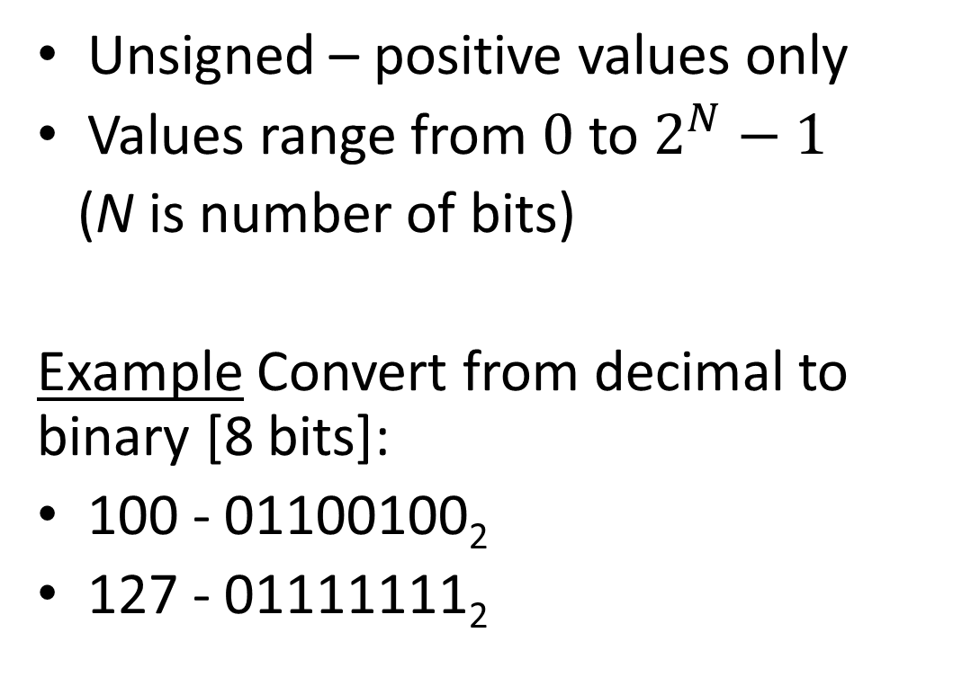
Unsigned Integer
Notes:
01100100
01111111

Slide 9
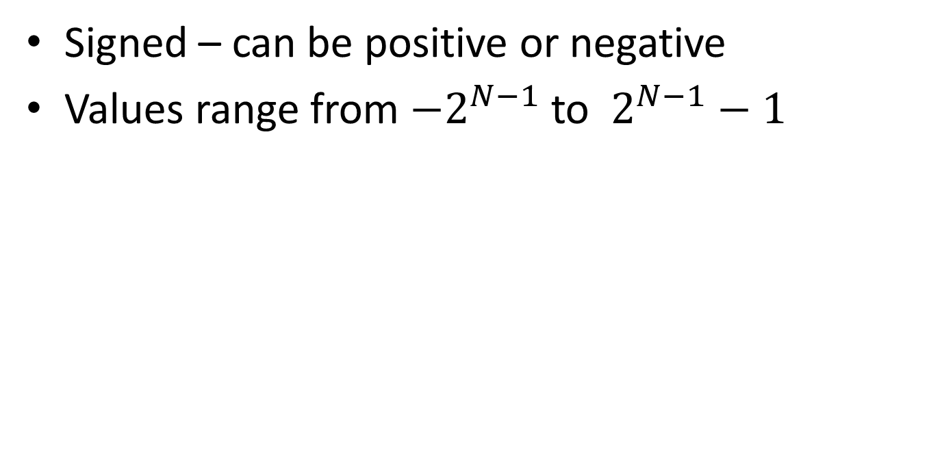
Signed Integer

Slide 10
Negative numbers in binary
Converting from decimal to binary
Apply Two’s complement:
Write number in binary
Invert the digits
Add 1
Example Convert from decimal to binary [8 bits]:
-100
100 is 01100100₂ so -100 is 10011011₂ + 1 = 10011100₂
-127
127 is 01111111₂ so -127 is 10000000₂ + 1 = 10000001₂

Slide 11
Floating point Numbers
Number is stored in three parts:
Sign bit
Exponent bits
Fraction (mantissa) bits
Sign bit
Exponent bits
Fraction bits

Slide 12
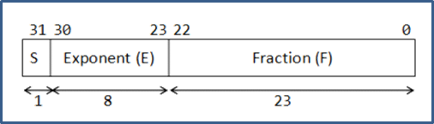
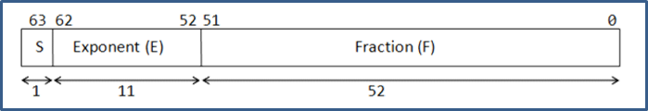
Bits for Floating point numbers
Single precision number with 32 bits
32: 1-8-23
Double precision number with 64 bits
64: 1-8-55

Slide 13

Floating point conversion (IEEE 754)
Conversion to binary number
Integral
fractional
Normalization of binary number
based on the bias
by shifting the decimal point such that we get a 1 at the very end

Slide 14
Conversion from decimal to binary
Example 1.
Determine the IEEE-754 Single Precision Floating-Point Numbers of decimal value 8.75
Step 1 - Conversion to binary number
Integral (8)
8₁₀ = 1000₂
fractional (0.75)
0.75 x 2 = 1.5 -> 1
0.5 x 2 = 1.0 -> 1
Binary representation of
8.75 is 1000.11

Slide 15
Conversion from decimal to binary
Example 1.
Determine the IEEE-754 Single Precision Floating-Point Numbers of decimal value 8.75
Step 2 - Normalization of Binary Number
Binary representation of 8.75₁₀ is 1000.11₂
Normalize 1000.11₂ by shifting the decimal point such that we get a single digit 1 before decimal point.
1000.11₂ = 1.00011₂ x 2³
That is, by shifting 3 decimal places to the left.

Slide 16
Conversion from decimal to binary
Example 1.
Determine the IEEE-754 Single Precision Floating-Point Numbers of decimal value 8.75
Obtain this format:
1000.11₂ = 1.00011₂ x 2³
= (-1)⁰ x (1 + 0.00011₂) x 2³
S = 0
F = 00011
E-bias = 3
E-127 = 3
E=130₁₀ =10000010₂
IEEE-754 Single Precision Floating-Point Numbers of decimal value 8.75 is
0 10000010 00011000000000000000000

Slide 17
Conversion from binary to decimal
Example 2. Determine the decimal value of
0 10000000 11000000000000000000000₂
based on IEEE-754
Based on this format:
0 10000000 11000000000000000000000₂
= (-1)⁰ x (1 + 0.1100₂) x 2^{10000000(base2)-127(base10)}
= 1 x (1.1100₂) x 2^{128(base10)-127(base10)}
= (1.1100₂) x 2¹
= 11.100 ₂
S
E
F
integral, 11₂ = 3
fractional, 0.100₂ =0.5
Thus, decimal value is 3.5

Slide 18
Character
character code used to represent :
letters of the alphabet and digits
printable symbols e.g. + *, &
unprintable characters - Backspace, Form Feed, Carriage Return, etc.
Types of codes :
EBCDIC (Extended Binary Coded Decimal Interchange Code) based on 8 bits used by IBM
ASCII (American Standard Code for Information Interchange) based on 7 bits used by others
Unicode characters include the basic ASCII character set and later expanded to include other characters like Arabic, Chinese, Japanese and other characters

Slide 19
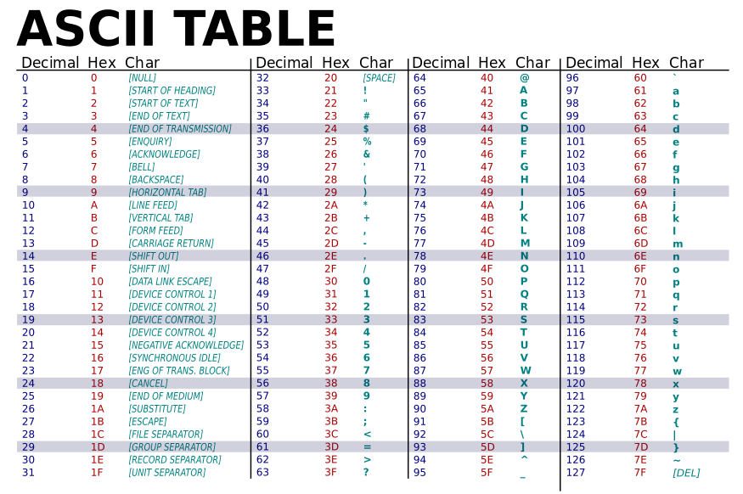
The ASCII table

Slide 20
Boolean type
Value true or false which is stored as 1 or 0
represents the value with logical and relational operators

Slide 21
Using Boolean variable
Using Boolean Variables
Boolean variables is useful to program a particular scenario, e.g. if a certain criteria is achieved or some values were obtained
Some examples:
to denote if game is over
if a certain rules has been compromised
certain search value is matched

Slide 22
Compound Data Types
Arrays
Classes / structures
Enumerated Types
Union
Pointers

Slide 23
Arrays
A collection of data of same type – Homogenous data type
Linear compound data type with fixed size
Subscript value – index
Dimension of Arrays – 1, 2, 3, 4, .. N

Slide 24
Operation on Arrays
Access an item
Insert a new item
Delete an item

Slide 25
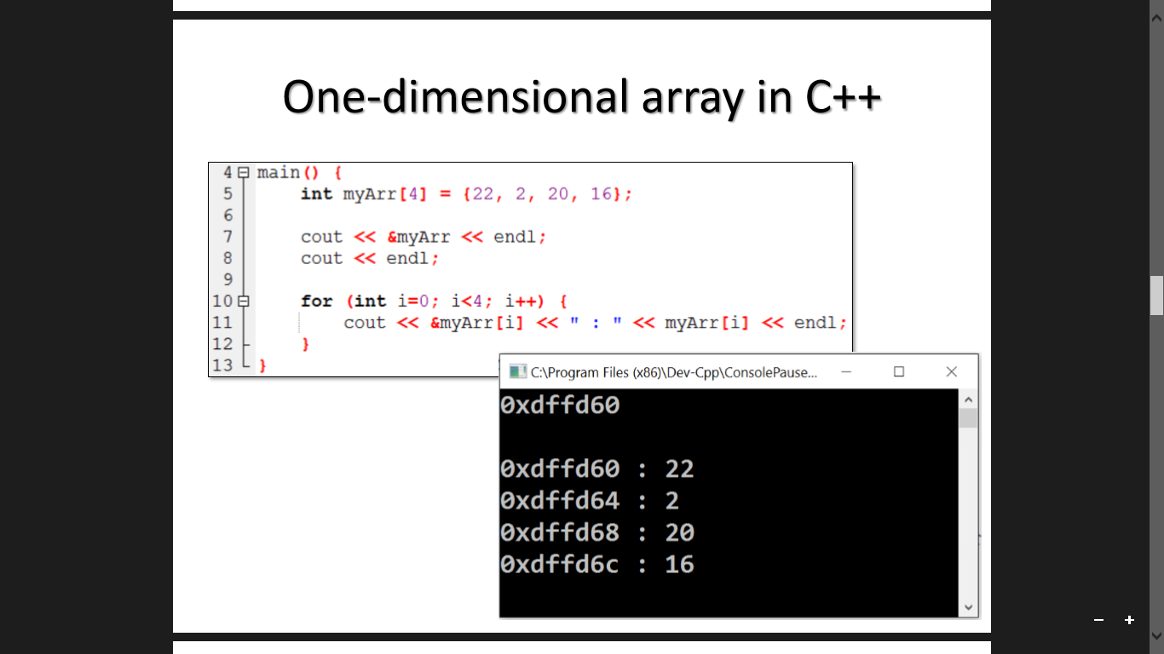
One dimensional Array in C++

Slide 26
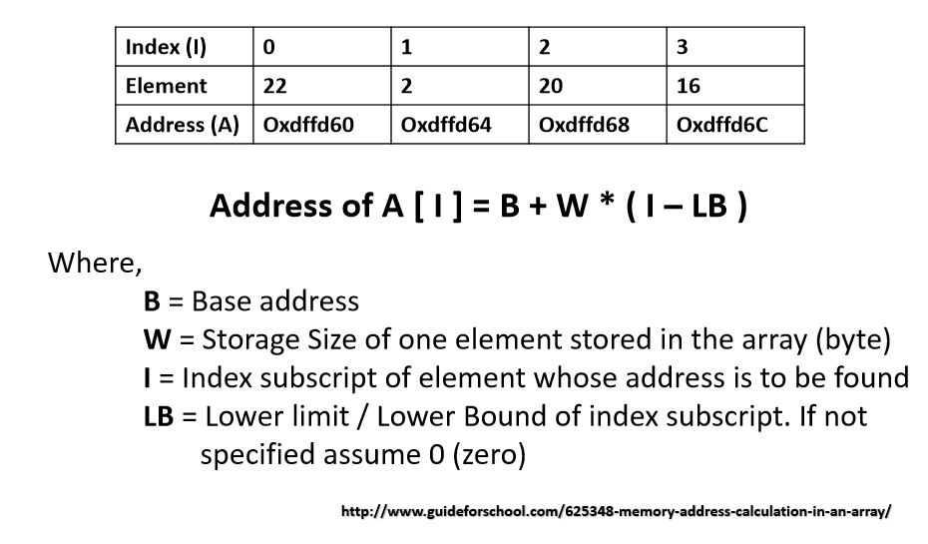
Address of Array Elements

Slide 27
Row Major and Column Major Address Calculation
In computing, row-major order and column-major order are methods for storing multidimensional arrays in linear storage such as random access memory
Different programming languages may use different data layout when passing arrays

Slide 28
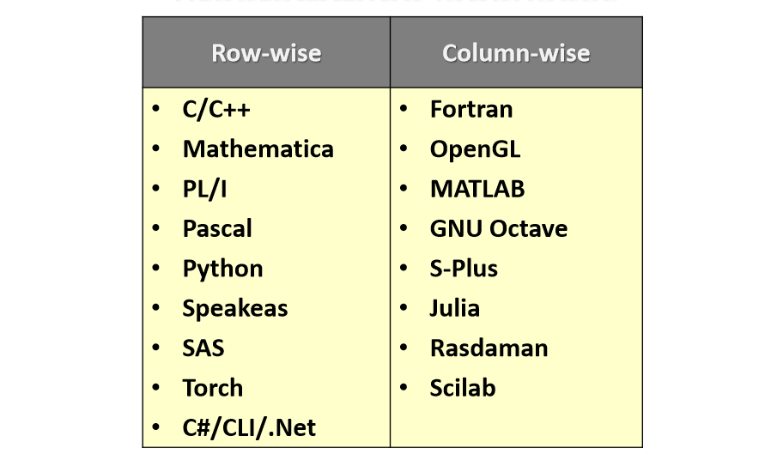
Row versus Column-wise based on Programming Language

Slide 29
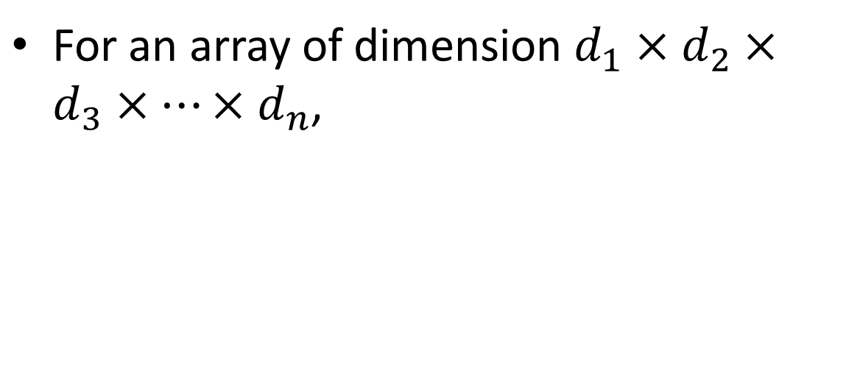
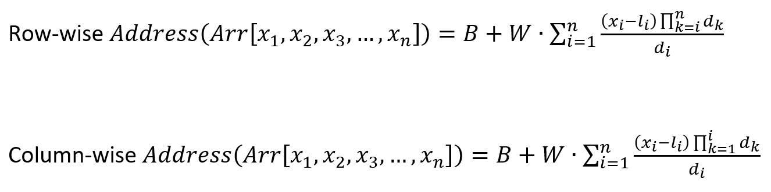
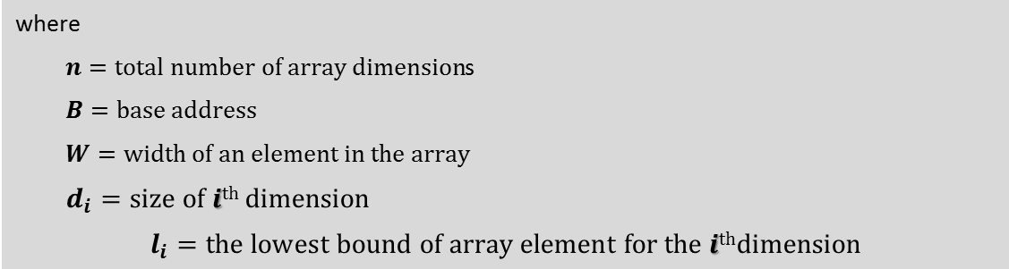
Calculating address of array element (Row-wise)

Slide 30

Calculating address of array element (Column-wise)

Slide 31
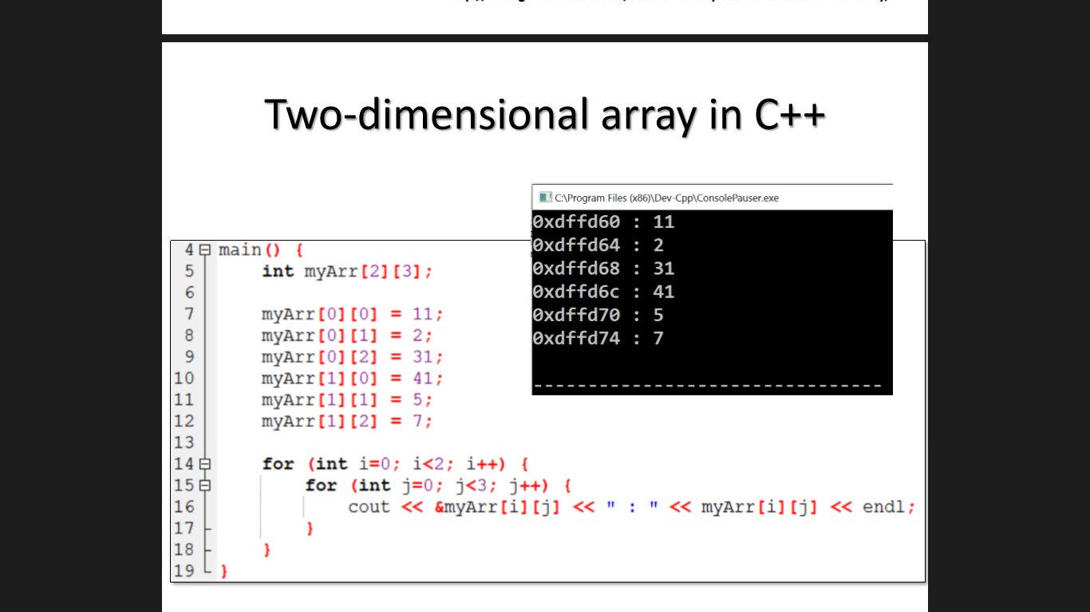
Two dimensional Array in C++

Slide 32
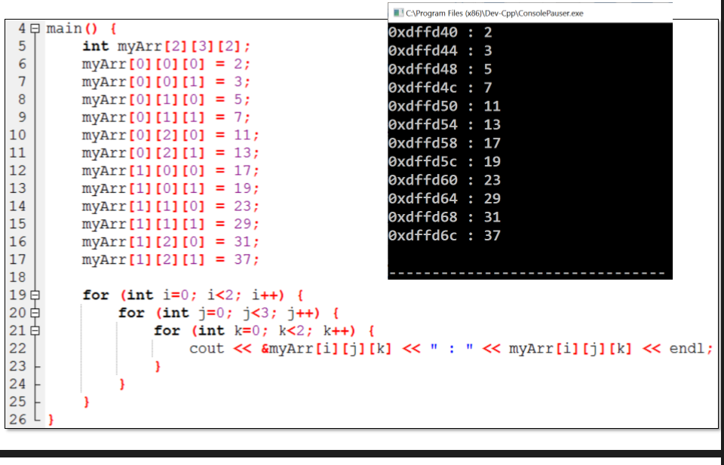
Three dimensional Array in C++

Slide 33
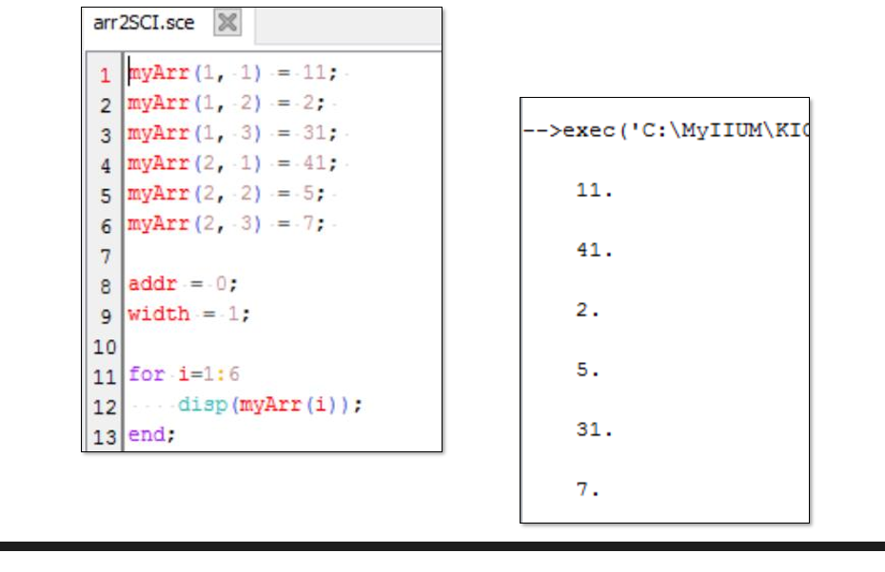
Two dimensional Array in SciLab

Slide 34
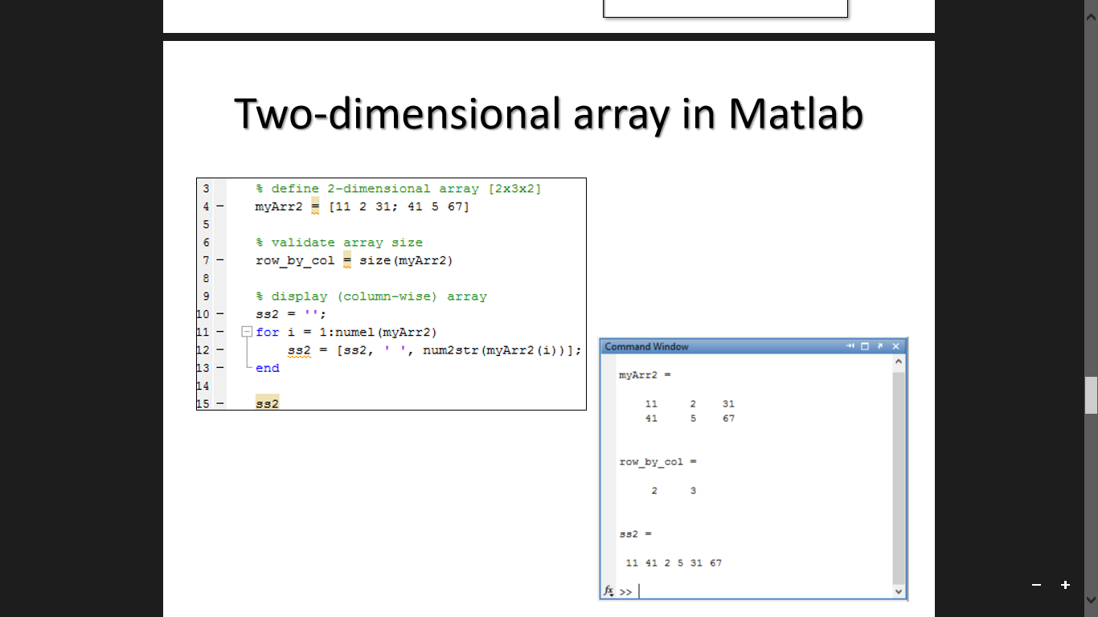
Two dimensional Array in MatLab

Slide 35
Example
Question:
Using column-wise method, calculate the address of element indexed as [6, 4, 7, 5] in an integer array of dimensions 6x7x8x9, where the base address, B = 173.

Slide 36
Pointers
Stores addresses of the next data
Self referential structure
Dynamic Memory allocation
location not fixed
memory location not contiguous
15
10
\

Slide 37
Operation with Pointers
Declare pointers
Define variables of pointer
Access values at address
Insert a pointer
Delete a pointer

Slide 38
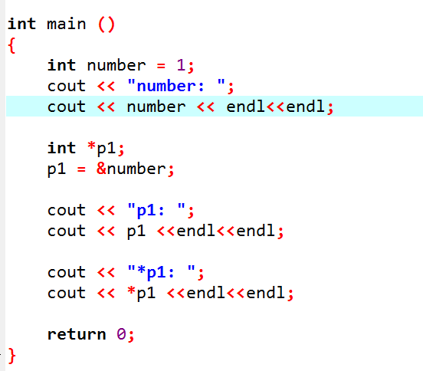

Slide 39
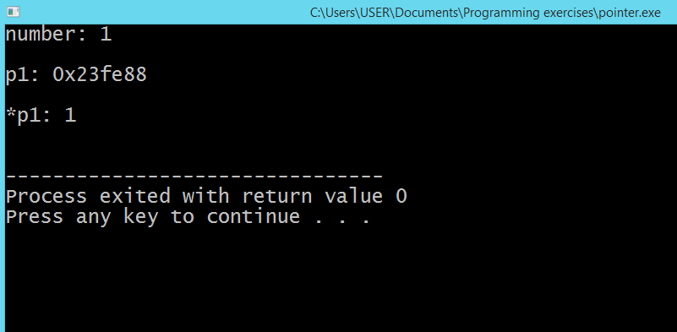

Slide 40
Class
Implemented in Object-Oriented Programming
Class describes attributes and methods of objects that belong to it
Attributes: variables (data)
Methods: functions
Objects: instance of a class

Slide 41
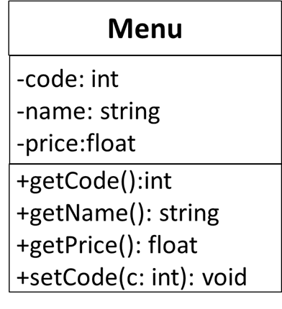
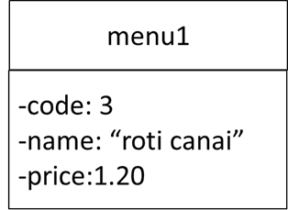
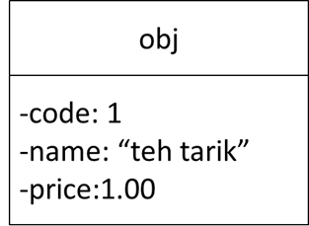
Example of Class
Menu is a Class
menu1 and obj are objects of class Menu

Slide 42

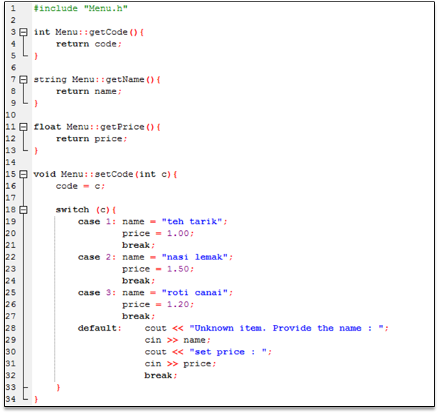

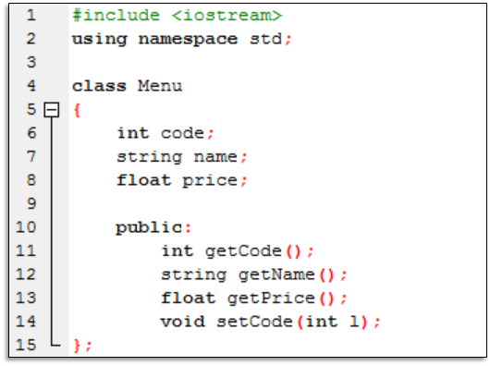
Implementation of Menu class

Slide 43
Data Types
From Data Types to Abstract Data Types
Data type
a set of objects + a set of operations
Example: integer
set of whole numbers
operations: +, -, x, /
Can this be generalized?
e.g. procedures generalize the notion of an operator
Yes!

Slide 44
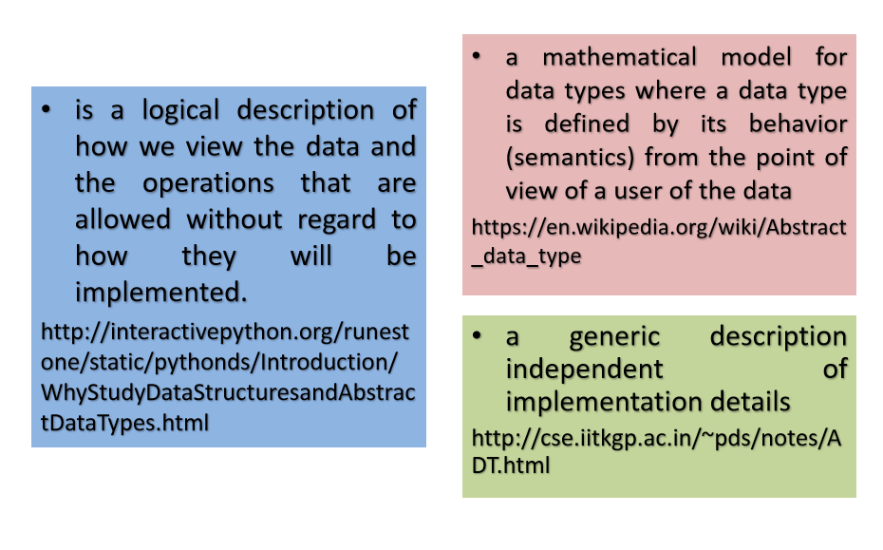
Abstract Data Types (ADT)

Slide 45
Examples of ADT…
Examples
the set ADT
A set of elements
Operations: union, intersection, size and complement
the queue ADT
A set of sequences of elements
Operations: create empty queue, insert, examine, delete, and destroy queue
Two ADT’s are different if they have the same underlying model but different operations
E.g. a different set ADT with only the union and find operations
The appropriateness of an implementation depends very much on the operations to be performed

Slide 46
Pros and Cons
Implementation of the ADT is separate from its use
Modular: one module for one ADT
Easier to debug
Easier for several people to work simultaneously
Code for the ADT can be reused in different applications
Information hiding
A logical unit to do a specific job
implementation details can be changed without affecting user programs
Allow rapid prototyping
Prototype with simple ADT implementations, then tune them later when necessary
Loss of efficiency

Slide 47
Purpose of Data Structures
managing complexity through abstraction

Slide 48
Data Structures
Lists
Stacks
Queues
Trees
Graphs
Tables

Slide 49
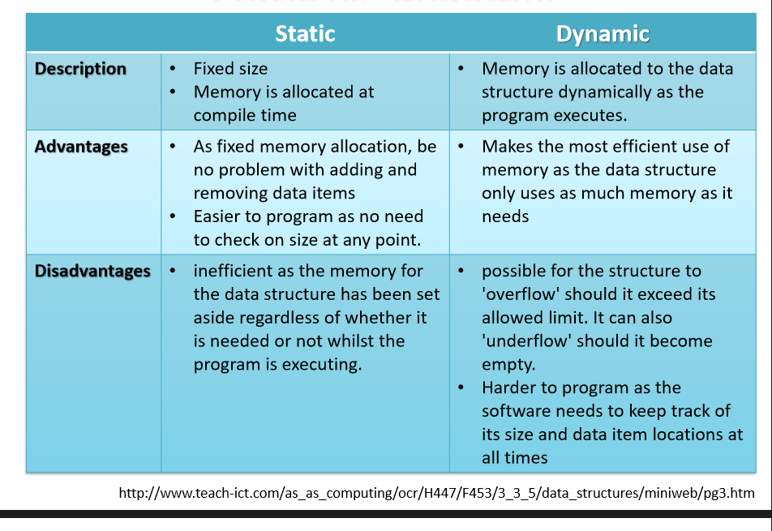
Static vs Dynamic

Slide 50
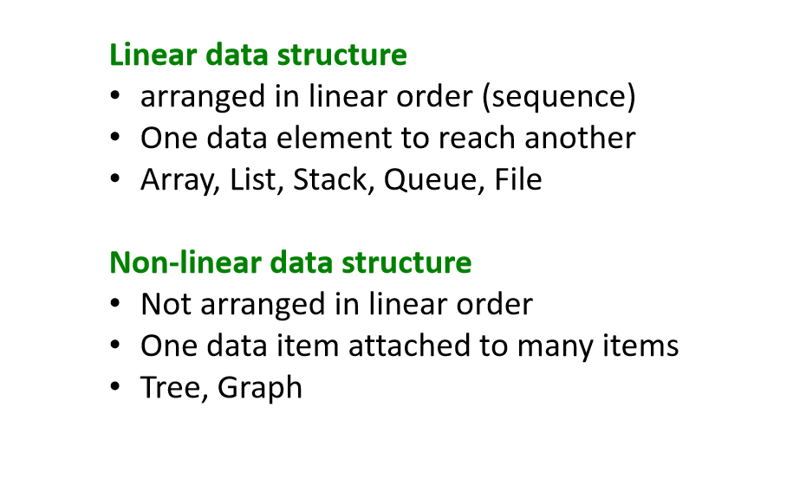
Linear vs Non-linear

Slide 51
End of Slides

